Slide 1

Transformers - Implementation and Experimentation
DEEP LEARNING (AI5100)
Course Instructor : Dr. Sumohana Channappayya
Presented by: Group ID 25, Presentation Group ID 18
Sanyog Sharma (AI21MTECH12003), Arvind Roshaan (AI21MTECH12004),
Billakurthi Shai Sasi Deep (SM21MTECH12006), H.N Srikanth (SM21MTECH12012),
Deevanshu Gupta (SM21MTECH12014)
Notes:
Developed by top notch scientists from GOOgle brain which is under google AI. This is one of the all time best papers in NLP. Thanks for accepting us to work on this

Slide 2
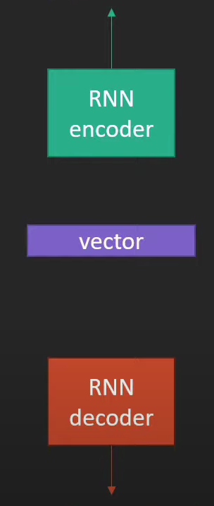
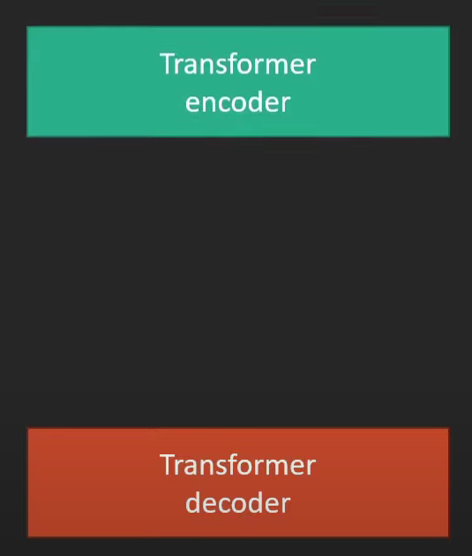
क्या वे बीमार थे?
मैं भी उनके पीछे था।
मैं भी उनके पीछे था।
RNNs deal sequences sequentially word to word.
Transformers processes whole sequence once.
And with parallelization it attains power.
But how..
I was close behind him.
I was close behind him.
Notes:
Hindi to English conversion.
RNNs are problematic with longer sequences.

Slide 3
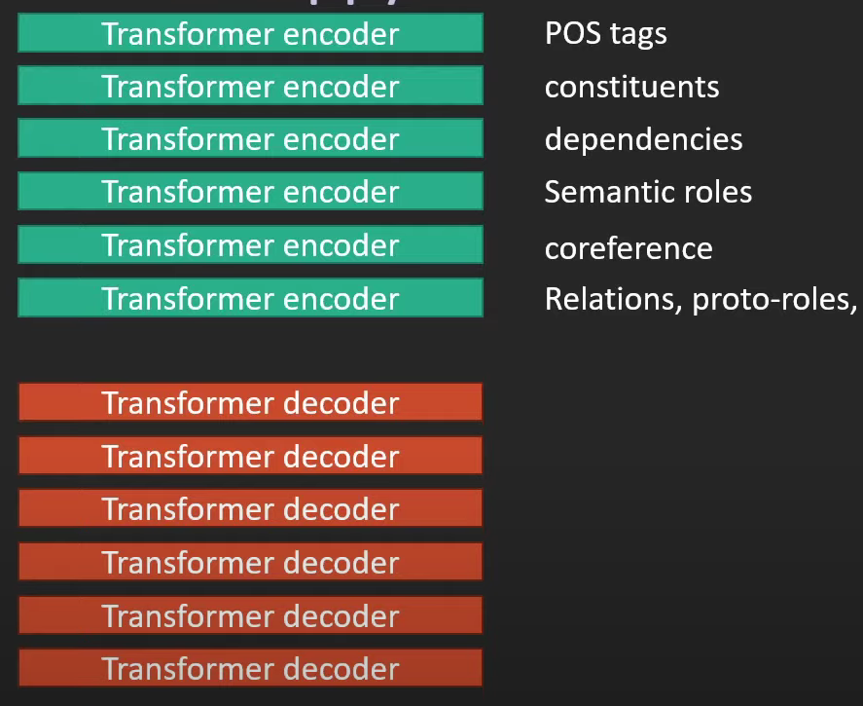
मैं भी उनके पीछे था।
Transformer is an Encoder-Decoder based architecture.
Stacking of Encoders ables transformer to catch raw properties of the sequence.
Functionalities in Decoder are almost similar to Encoder.
I was close behind him.
Notes:
Properties such as Parts of Speech, constituents, dependencies semantic roles, coreference are learnt.
Encoder takes input sequence into latent space and Decoder acts from it.

Slide 4
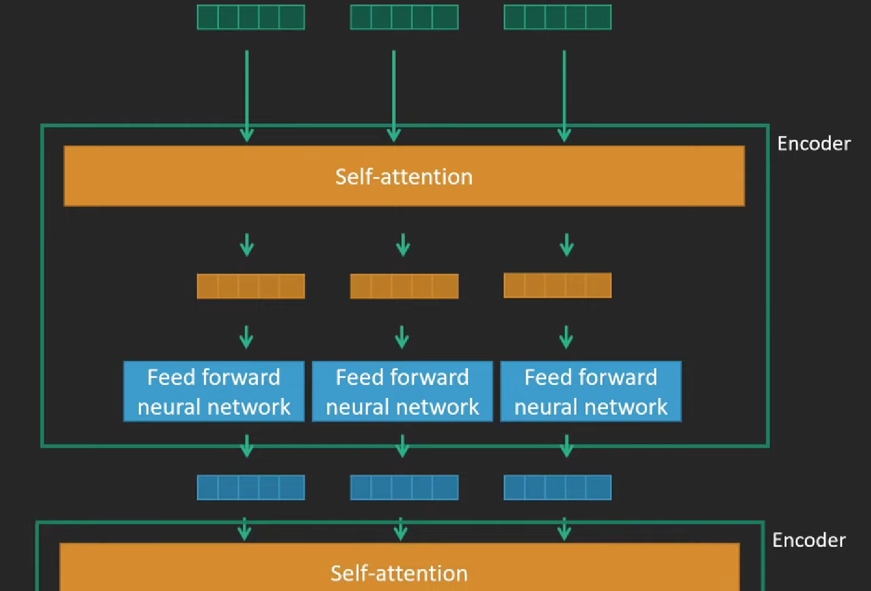
मैं भी उनके पीछे था।
The computation per path can be done in parallel to recurrent neural networks where one word has to wait for the output from the previous word.
Parallelization speeds up training considerably, and thus the transformer can be trained relatively on a massive amount of text.
I was close behind him.
Notes:
Parallelisation
After the self Attention layer computed on the input its output vector, taking into account the dependencies of words between each other, it passes its vector onto simple,
Feed forward neural network these sending the processes output further to the next encoder
Layer formed after the same encoder blueprint
The computation per path can be done in parallel in contrast to recurrent neural networks where one words has to wait for the output from the previous word
Parallelization speeds up training considerably and thus the transformer can be trained relatively on a huge amount of text.
For word order we use encoder

Slide 5
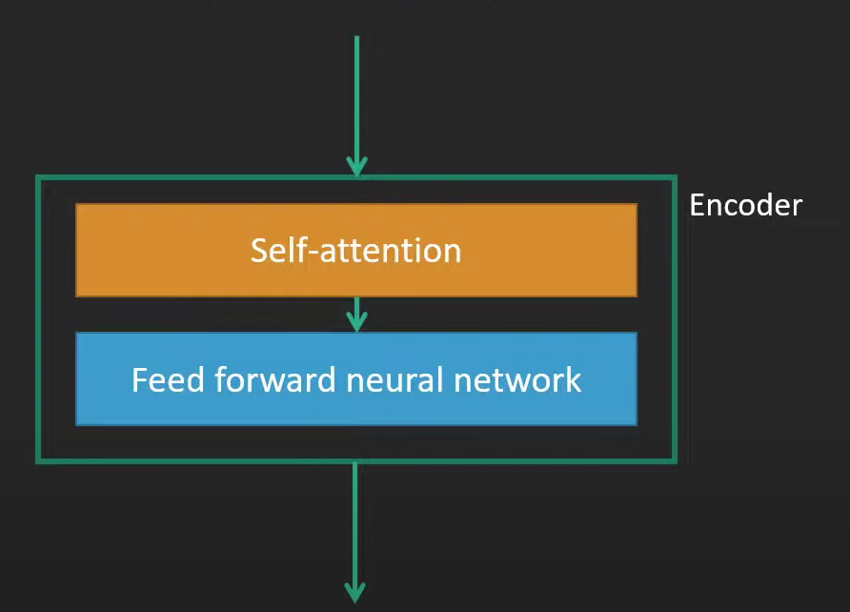
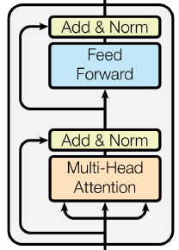
मैं भी उनके पीछे था।
All Encoders consists of similar Self-attention and Feed forward neural network parts.
1st Encoder generates Query, key value matrices of the input tokens.
A residual connection is employed between two sublayers followed by layer Normalization and dropout.

Slide 6
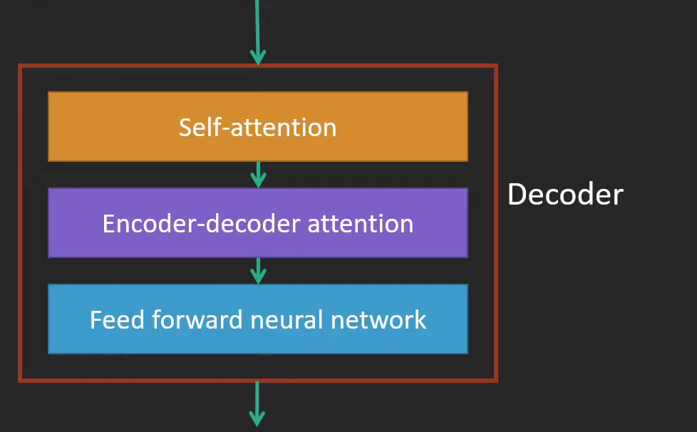
Decoder consists of similar blocks as Encoder except Encoder-Decoder attention layer.
Decoder takes keys and values from Encoder and Query from the targeted sequence.
These Query, key, value matrices are passed through attention of Decoder.
I was close behind him.

Slide 7
Attention
Self-Attention
आप उनको हल कैसे करेंगी?
आप उनको हल कैसे करेंगी?
आप उनको हल कैसे करेंगी?
How do you propose to solve them?
Attention catches similarities between two different sequences that is required in Decoder.
Where as Self-attention catches dependencies in the same sequence which is done in both Encoder and Decoder.
Notes:
In Attention ‘aap’ and ‘kaise’ are related to the translated words you and how.
In Self-attention dependencies between ‘aap’ and ‘unko’ are detected which happens in both encoder and decoder.

Slide 8
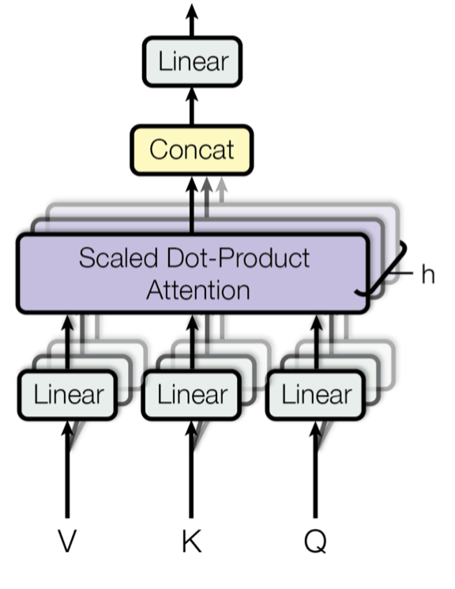
Transformers perform these attention and self - attention operations with multi heads which brings its power of parallelization.
Multi head outputs are concatenated at the end linearly projected to form desired output dimension.
Notes:
From here we can understand how each word flows on its own path and how operations in these paths happen parallely ,unlike RNNs which wait for the previous output.

Slide 9
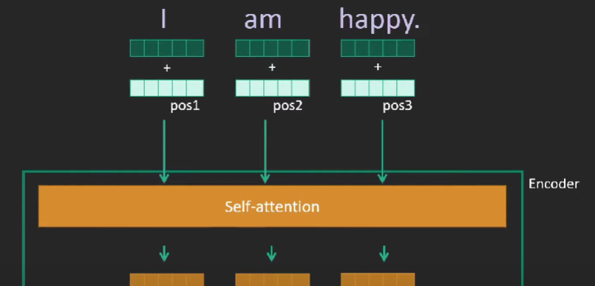
वह करूणामयी हैं।
Positional Encoding is done by adding positional vector with each input vector.
This makes network to know which word is at which position.
Notes:
Positional encoding gives position of each word which has to remembered by the network.

Slide 10
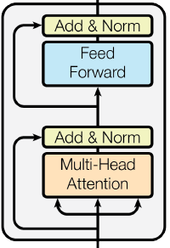
The output of each layer here, the input is added to the output of the next sublayer; this is called a residual connection.
This enables a better flow of information through the network, so the information is not lost without a chance for the next layer to recover.
Residual connection is done with every layer
Notes:
Residual
The output of each layer here, the input is added to the output of the next sublayer; this is called a residual connection and enables a better flow of information through the network, so the information is not lost without a chance for the next layer to recover. This happens for every layer

Slide 11
Generating the output sequence
At the final output computation, the very last layer of the network is the softmax layer which assigns probabilities for each word in vocabulary sums to one.
Here it assigns probabilities to each word and stops when it reaches the highest prediction, which is the stop, i.e., the final word in the sentence.
This is what a trained model should give us reasonable probabilities over this vocabulary.
Notes:
Dev
This is where the Magic in the decoder happens.
The decoder has the same structure as the encoder with the only difference, that it has an encoder-decoder attention layer in the middle so the decoder, processes the vector like the encoder, but also computes attention between the decoder vector and the output of the first encoder.
This helps the decoder to focus on the appointment input parts.
At the final output computation the very last layer of the network is the softmax layer which assigns probabilities for each word in vocabulary sums to one.
Here it assigns probabilities to each word and stops when it reaches the highest predict which is the stop i.e. the final word in the sentence.
This is what a trained model should give us reasonable probabilities over this vocabulary
At training time we have first a model unable to predict reasonable probabilities, so we teach it.
Run it on text, these could be sentences and their translation, where we know what the next word should be.

Slide 12
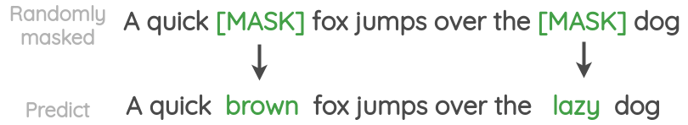
Next word is not necessarily predicted because model can also be trained to predict a randomly masked word.
Model is penalized and updated through backpropagation until it does reasonably well in training.
Notes:
Masked Word Prediction
This picture clearly shows masked prediction.

Slide 13
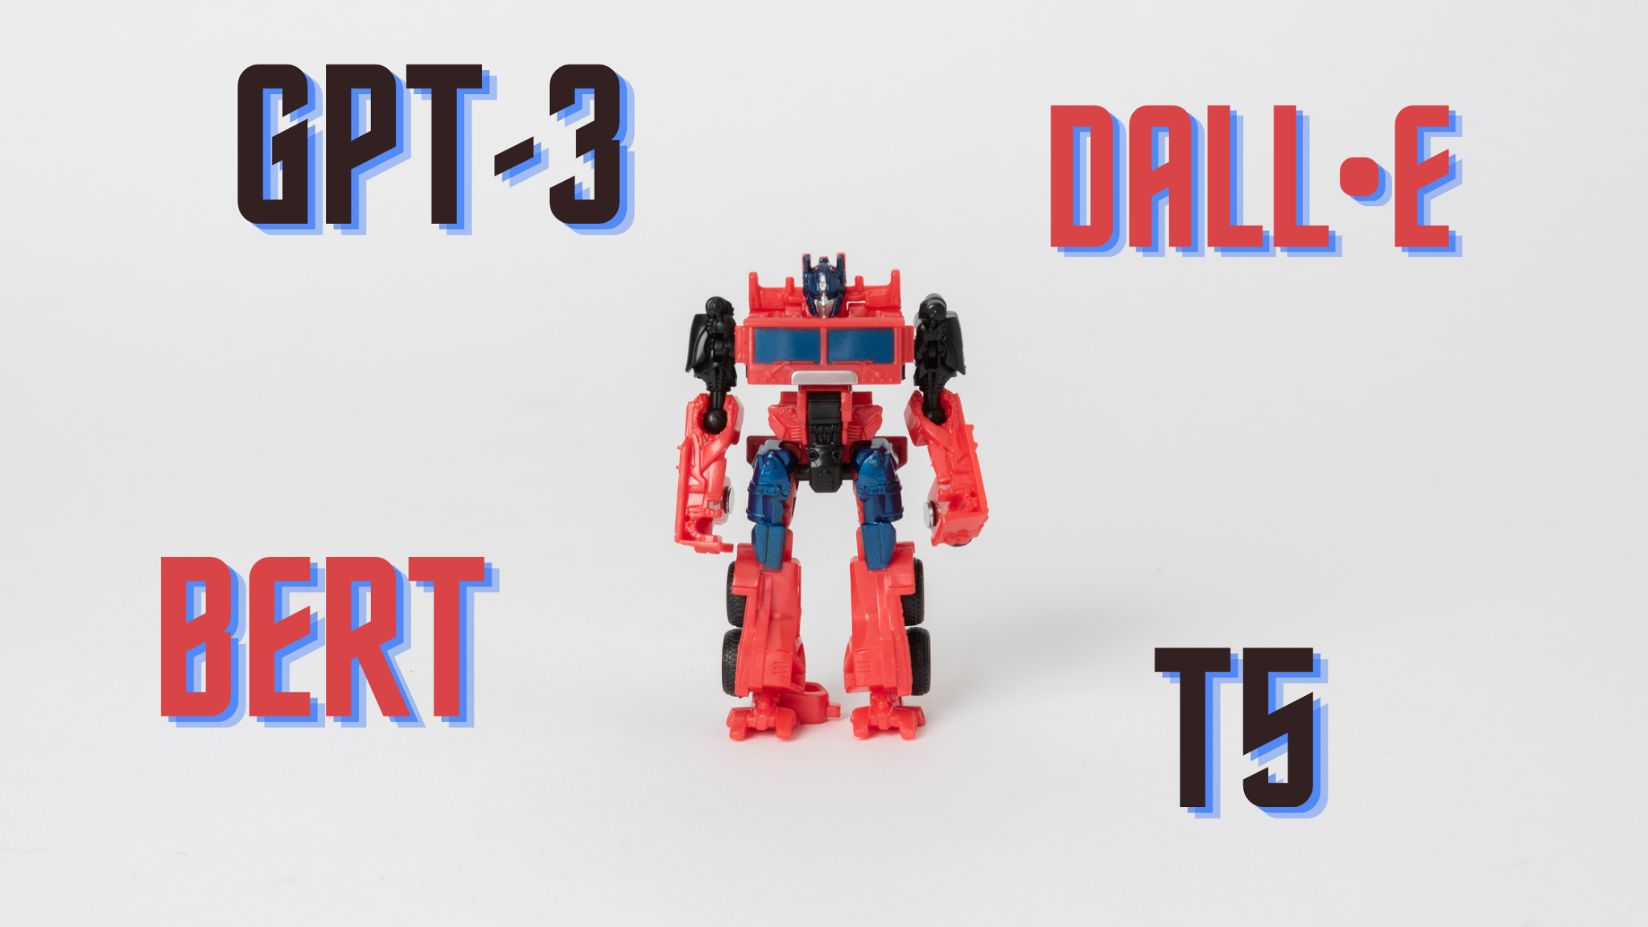
Transformers easily get trained with Self supervision, They don’t rely on annotated data.
As Transformers are trained to predict masked words it works well on tasks like text completion.
Transformers which are learnt on one complete corpus can be used on multiple other tasks.
As of today all top models like BERT, GPT3, T5, DALL-E are based on Transformers.
Notes:
BERT (Bi directional Encoder Representations from Transformers),
GPT Generative Pretrained Transformer
T5 Text to Text Transfer Transformer
DALL E version of GPT3 which generates images based on text

Slide 14
Experimentation with the existing Implementation
We experimented with an existing Transformer implementation by FairSeq¹. Originally, the model was trained on IWSLT’14 German to English dataset.
Trained model from scratch on a subset of IIT Bombay English-Hindi Corpus² called Book Translations (Gyaan-Nidhi Corpus).
Gyaan-Nidhi Corpus | Number of Sentences | Average words per Sentence
 |  | English | Hindi
Training data | 207,804 | 19.841 | 20.245
Validation data | 9,874 | 19.744 | 20.074
Testing data | 9,445 | 20.030 | 20.456
¹https://github.com/pytorch/fairseq
²https://www.cfilt.iitb.ac.in/iitb_parallel/

Slide 15
Experimentation with the existing Implementation
Below are the list of configurations that we experimented with
6E-6D with L2_wd_10^-4 (original configuration)*
7E-7D with L2_wd_10^-4 *
8E-8D with L2_wd_10^-4 *
6E-6D with L2_wd_10^-3 *
6E-6D with L2_wd_10^-3 with transliteration of Hindi sentences to English *
6E-6D with L2_wd_10^-3 with preprocessing of Hindi and English sentences *
2E-2D with Bi-directional GRU BBPE tokenization (4096 tokens) with preprocessing of sentences
Configuration | 1 | 2 | 3 | 4 | 5 | 6 | 7
Training Loss | 2.901 | 2.883 | 3.237 | 2.332 | 2.498 | 2.035 | 2.67
Validation Loss | 5.231 | 5.334 | 5.227 | 3.538 | 3.878 | 3.333 | 3.492
Models 1 to 6 roughly 7 hours each for 350 epochs and Model 7 took roughly 14 hours for 250 epochs
*BPE tokenization method was used with 10K tokens

Slide 16
Experimentation with the existing Implementation
BLEU (BiLingual Evaluation Understudy) is a metric for automatically evaluating machine-translated text. The BLEU score is a number between zero and one that measures the similarity of the machine-translated text to a set of high quality reference translations.
Below mentioned are BLEU-4 scores for various configuration:
Configuration | 4 | 5 | 6 | 7
Training Data | 0.2429 | 0.3075 | 0.3133 | 0.2726
Validation Data | 0.1419 | 0.1214 | 0.1982 | 0.2142
Test Data | 0.1437 | 0.1211 | 0.1982 | 0.2121

Slide 17
Sample Translations
Source Sentence | इस तथ्य ने सिपाहियों की धार्मिक भावनाओं को उभारा और उनमें क्रोध पैदा हुआ। | उन्होंने बंबई विश्वविद्यालय से स्नातक की परीक्षा पास की और अपना सारा जीवन राष्ट्र की सेवा में लगा दिया।
Ground Truth | the sepoys were angered at this affront to their religious feelings . | He graduated from the Bombay University and devoted his entire life to the service of the country.
BPE 10K tokens (configuration 4) | The fact created a stir among the sepoys and angered them. | He passed the graduate examination from the Bombay University and devoted his whole life to the service of the nation.
BPE 10K tokens (configuration 6) | this fact aroused the religious feelings of the soldiers and resented them . | he passed the graduate examination from the bombay university and devoted his life to the service of the nation .
BBPE 4K tokens (configuration 7) | this enlightened the religious sentiments of the soldiers and anger was created in them. | he passed the graduate from the university of bombay and spent his life in the service of the nation.

Slide 18
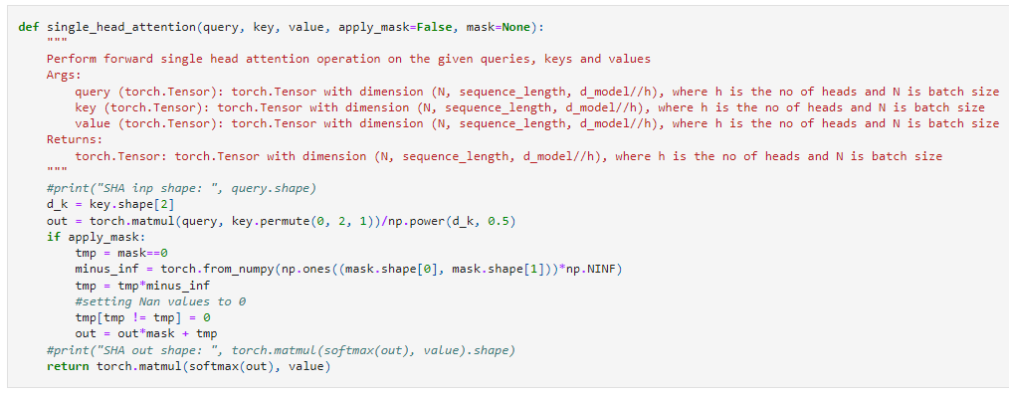
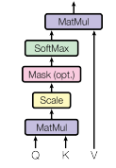
Single Head Attention

Slide 19
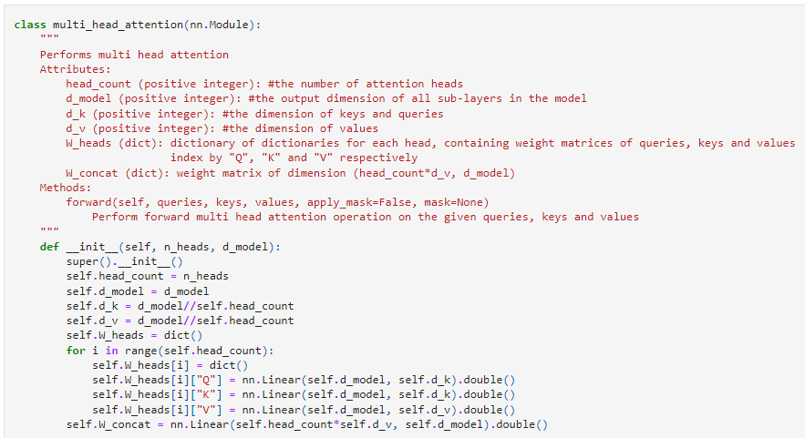
Multi Head Attention

Slide 20
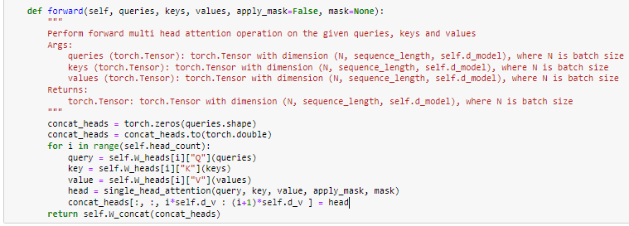
Multi Head Attention

Slide 21
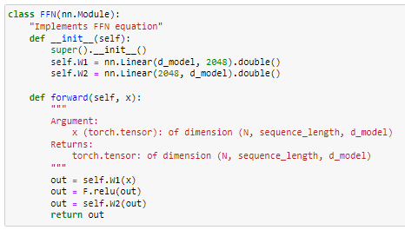
Fully Connected layer

Slide 22
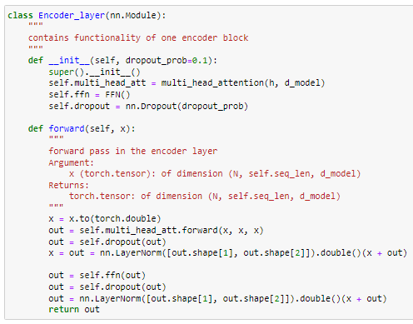
Encoder Layer

Slide 23
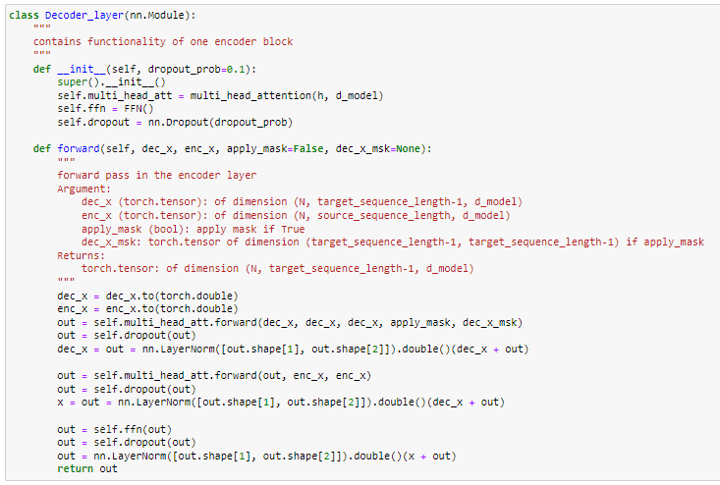
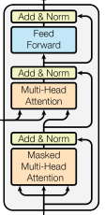
Decoder Layer

Slide 24
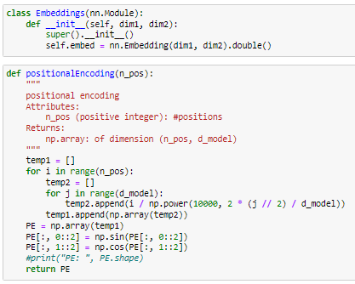
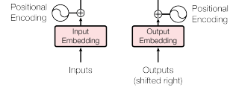
Embedding and Positional Encoding

Slide 25
Implementation of Transformer Architecture using PyTorch
Task: Learning Identity mapping between input and target number sequence. Each entry of the sequence is a number between 1 to 10 (both inclusive). Vocabulary size is 10
Example:
Input: 4, 6, 9, 1, 10, 6, 5, 7
Ground Truth: 4, 6, 9, 1, 10, 6, 5, 7
Training Data: 100 randomly generated examples of sequence length 8
We implemented a 6 encoder 6 decoder Transformer architecture using PyTorch. We used ADAM optimizer and trained over 200 epochs
We chose d_model to be 512 and number of heads to be 8

Slide 26
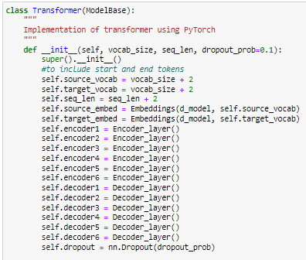
Transformer

Slide 27
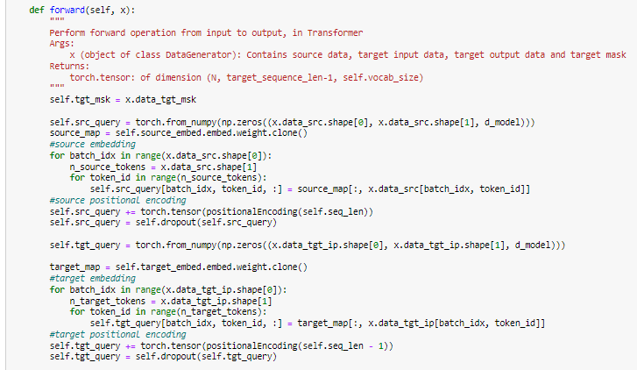
Transformer - Forward pass - Source and Target processing

Slide 28
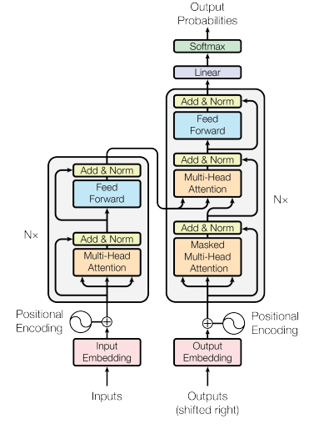
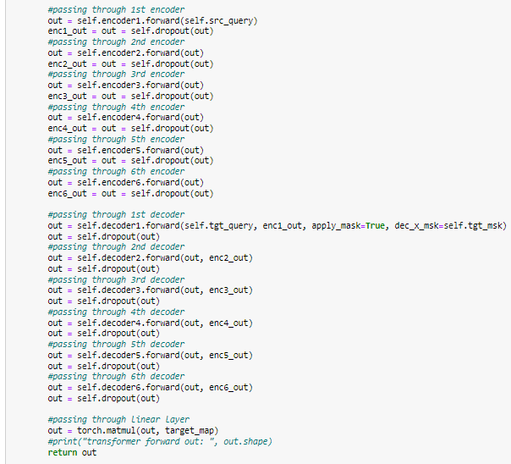
Transformer - Forward pass

Slide 29
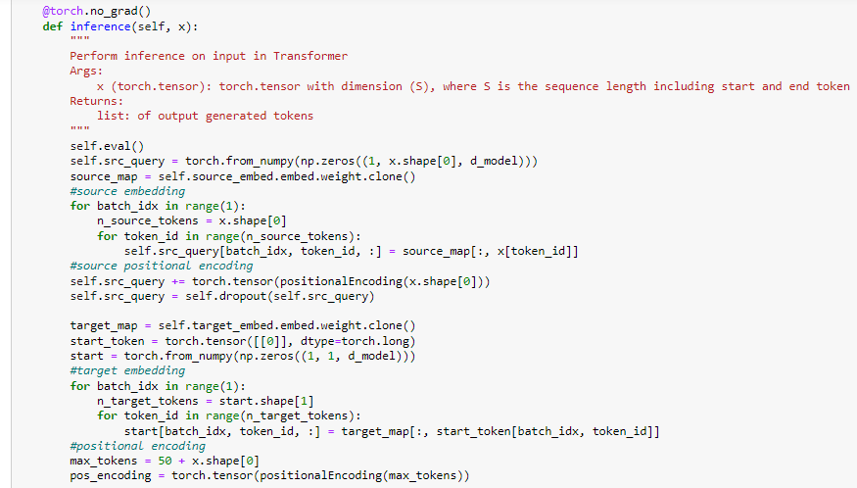
Transformer - Inference

Slide 30
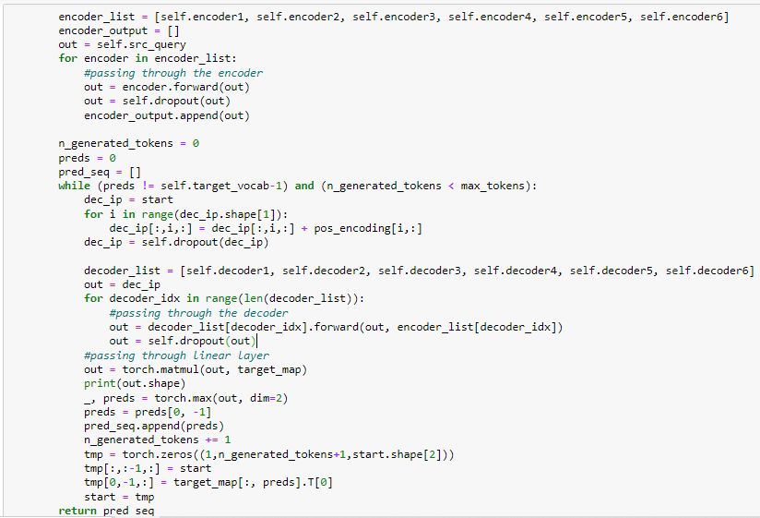
Transformer - Inference

Slide 31
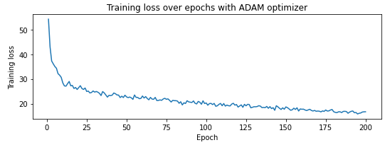
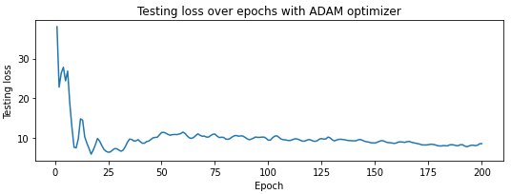
Results

Slide 32
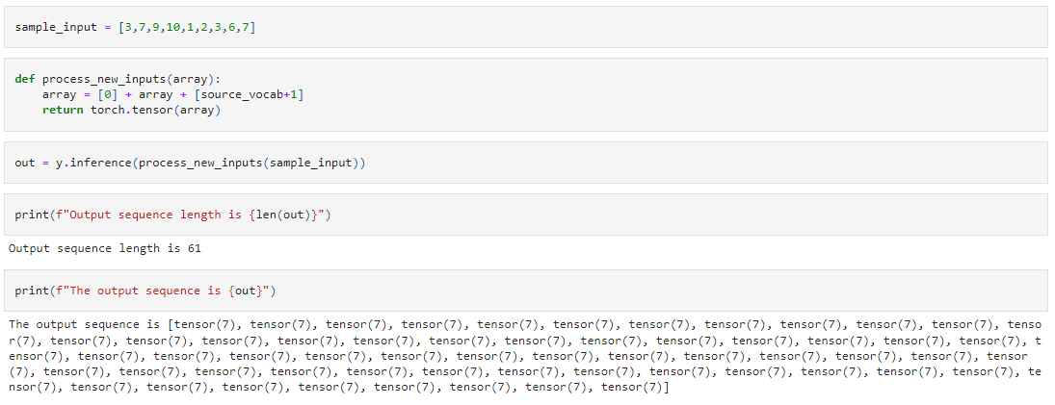
Results

